Slide 1

Classification of precursor microRNAs in various groups of organisms using Machine Learning algorithms
By Mohammad Atif Hussain (190106036)
Under Supervision of :- Prof. Utpal Bora

Slide 2
Objective

Slide 3
To analyse the variations of different parameters used in creation of ML methods for pre-miRNA prediction, in various classes of organisms.

Slide 4
Introduction

Slide 5
MicroRNAs are non coding RNA.
MicroRNAs control gene expressions.
.Long primary miRNAs that are capped and tailless like mRNAs are produced by RNA Pol II and III in the nucleus.
They normally have a length of 22 bp and bind to target mRNAs 3' untranslated region (3' UTR) to cause mRNA degradation and translational repression

Slide 6
Material and
Material and Methods:
Material and Methods:

Slide 7
We collected important data of Insects, Aves, Amphibia, Mammalia, Reptilia ,Rumins, Rice and Humans.
. We split the dataset into two parts train and test.
We used Synthetic Minority Oversampling Technique (SMOTE) for balancing the unbalanced data.
After that, Principal Component Analysis (PCA) was used to extract meaningful features.
And then we used XGBoost model for prediction.

Slide 8
Result

Slide 9
There are total of 111 features used in prediction of classes.After evaluation we got results as given below:-
· Insects has highest Sensitivity
· Rice has highest Specificity
· Insects has highest Precision
· Insects has highest F1_Score
· Insects has highest MCC
· Rice has highest Accuracy
· Sauria has highest AUC score

Slide 10
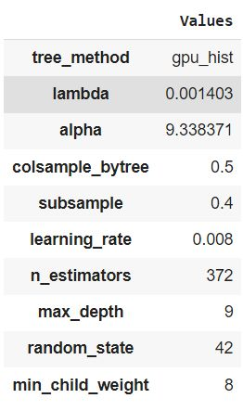
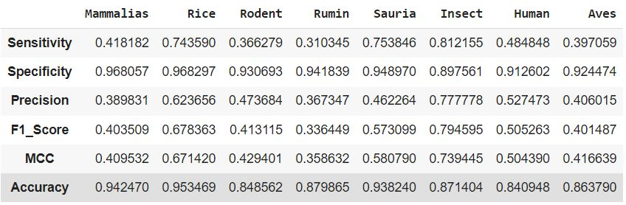
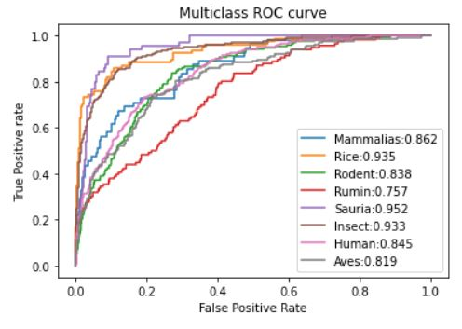

Slide 11
Conclusion and Future Work:

Slide 12
Rice, Sauria, and insects can all be clearly distinguished. Mammalia, Aves, and humans all have similar AUC scores, and Rumins are difficult to tell apart. Other classification methods will need to be used to fine-tune the parameters through additional analysis. Our source code is available as open source via the GitHub link. From this preliminary work, a tool for classifying pre-miRNA according to species specificity can be created in the future.

Slide 13
References

Slide 14
[1] M. Ha and V. N. Kim, ‘Regulation of microRNA biogenesis’, Nature Reviews Molecular Cell Biology 2014 15:8, vol. 15, no. 8, pp. 509–524, Jul. 2014, doi: 10.1038/nrm3838.
[2] J. P. Broughton, M. T. Lovci, J. L. Huang, G. W. Yeo, and A. E. Pasquinelli, ‘Pairing beyond the Seed Supports MicroRNA Targeting Specificity’, Mol Cell, vol. 64, no. 2, pp. 320–333, Oct. 2016, doi: 10.1016/J.MOLCEL.2016.09.004.
[3] R. C. Lee, R. L. Feinbaum, and V. Ambros, ‘The C. elegans heterochronic gene lin-4 encodes small RNAs with antisense complementarity to lin-14’, Cell, vol. 75, no. 5, pp. 843–854, Dec. 1993, doi: 10.1016/0092-8674(93)90529-Y.
[4] B. Wightman, I. Ha, and G. Ruvkun, ‘Posttranscriptional regulation of the heterochronic gene lin-14 by lin-4 mediates temporal pattern formation in C. elegans’, Cell, vol. 75, no. 5, pp. 855–862, Dec. 1993, doi: 10.1016/0092-8674(93)90530-4.
[5] G. M. Borchert, W. Lanier, and B. L. Davidson, ‘RNA polymerase III transcribes human microRNAs’, Nature Structural & Molecular Biology 2006 13:12, vol. 13, no. 12, pp. 1097–1101, Nov. 2006, doi: 10.1038/nsmb1167.
[6] Y. Lee et al., ‘MicroRNA genes are transcribed by RNA polymerase II’, EMBO J, vol. 23, no. 20, pp. 4051–4060, Oct. 2004, doi: 10.1038/SJ.EMBOJ.7600385.

Slide 15
[7] Z. Xie, E. Allen, N. Fahlgren, A. Calamar, S. A. Givan, and J. C. Carrington, ‘Expression of Arabidopsis MIRNA Genes’, Plant Physiol, vol. 138, no. 4, pp. 2145–2154, Aug. 2005, doi: 10.1104/PP.105.062943.
[8] X. Belles, A. S. Cristino, E. D. Tanaka, M. Rubio, and M.-D. Piulachs, ‘Insect MicroRNAs’, in Insect Molecular Biology and Biochemistry, Elsevier, 2012, pp. 30–56. doi: 10.1016/B978-0-12-384747-8.10002-9.
[9] Q. Zhang et al., ‘Genome-Wide Analysis of MicroRNAs in Relation to Pupariation in Oriental Fruit Fly’, Front Physiol, vol. 10, Mar. 2019, doi: 10.3389/fphys.2019.00301.
[10] E. Gomez-Orte and X. Belles, ‘MicroRNA-dependent metamorphosis in hemimetabolan insects’, Proc Natl Acad Sci U S A, vol. 106, no. 51, pp. 21678–21682, Dec. 2009, doi: 10.1073/PNAS.0907391106/SUPPL_FILE/0907391106SI.PDF.
[11] L. Ling et al., ‘MicroRNA Let-7 regulates molting and metamorphosis in the silkworm, Bombyx mori’, Insect Biochem Mol Biol, vol. 53, pp. 13–21, Oct. 2014, doi: 10.1016/J.IBMB.2014.06.011.
[12] K. Tariq, W. Peng, G. Saccone, and H. Zhang, ‘Identification, characterization and target gene analysis of testicular microRNAs in the oriental fruit fly Bactrocera dorsalis’, Insect Mol Biol, vol. 25, no. 1, pp. 32–43, Feb. 2016, doi: 10.1111/imb.12196.

Slide 16
[13] Y. Zhang et al., ‘microRNA-309 targets the Homeobox gene SIX4 and controls ovarian development in the mosquito Aedes aegypti’, Proceedings of the National Academy of Sciences, vol. 113, no. 33, Aug. 2016, doi: 10.1073/pnas.1609792113.
[14] X. Zhang, Y. Zheng, G. Jagadeeswaran, R. Ren, R. Sunkar, and H. Jiang, ‘Identification of conserved and novel microRNAs in Manduca sexta and their possible roles in the expression regulation of immunity-related genes’, Insect Biochem Mol Biol, vol. 47, pp. 12–22, Apr. 2014, doi: 10.1016/j.ibmb.2014.01.008.
[15] C. Yin et al., ‘The genomic features of parasitism, Polyembryony and immune evasion in the endoparasitic wasp Macrocentrus cingulum’, BMC Genomics, vol. 19, no. 1, pp. 1–18, May 2018, doi: 10.1186/S12864-018-4783-X/FIGURES/6.
[16] K. Etebari, M. H. Afrad, B. Tang, R. Silva, M. J. Furlong, and S. Asgari, ‘Involvement of microRNA miR-2b-3p in regulation of metabolic resistance to insecticides in Plutella xylostella’, Insect Mol Biol, vol. 27, no. 4, pp. 478–491, Aug. 2018, doi: 10.1111/imb.12387.
[17] Y. Zhang et al., ‘A microRNA-1 gene, tci-miR-1-3p , is involved in cyflumetofen resistance by targeting a glutathione S-transferase gene, TCGSTM4 , in Tetranychus cinnabarinus’, Insect Mol Biol, vol. 27, no. 3, pp. 352–364, Jun. 2018, doi: 10.1111/imb.12375.

Slide 17
18] S. Jaiswal et al., ‘Development of species specific putative miRNA and its target prediction tool in wheat (Triticum aestivum L.)’, Scientific Reports 2019 9:1, vol. 9, no. 1, pp. 1–12, Mar. 2019, doi: 10.1038/s41598-019-40333-y.
[19] K. Y. Huang, T. Y. Lee, Y. C. Teng, and T. H. Chang, ‘ViralmiR: A support-vector-machine-based method for predicting viral microRNA precursors’, BMC Bioinformatics, vol. 16, no. 1, pp. 1–7, Jan. 2015, doi: 10.1186/1471-2105-16-S1-S9/TABLES/9.
[20] C. Xue, F. Li, T. He, G. P. Liu, Y. Li, and X. Zhang, ‘Classification of real and pseudo microRNA precursors using local structure-sequence features and support vector machine’, BMC Bioinformatics, vol. 6, no. 1, pp. 1–7, Dec. 2005, doi: 10.1186/1471-2105-6-310/TABLES/3.
[21] Md. E. Rahman, R. Islam, S. Islam, S. I. Mondal, and Md. R. Amin, ‘MiRANN: A reliable approach for improved classification of precursor microRNA using Artificial Neural Network model’, Genomics, vol. 99, no. 4, pp. 189–194, Apr. 2012, doi: 10.1016/j.ygeno.2012.02.001.
[22] P. Jiang, H. Wu, W. Wang, W. Ma, X. Sun, and Z. Lu, ‘MiPred: classification of real and pseudo microRNA precursors using random forest prediction model with combined features’, Nucleic Acids Res, vol. 35, no. suppl_2, pp. W339–W344, Jul. 2007, doi: 10.1093/NAR/GKM368.

Slide 18
[23] K. L. S. Ng and S. K. Mishra, ‘De novo SVM classification of precursor microRNAs from genomic pseudo hairpins using global and intrinsic folding measures’, Bioinformatics, vol. 23, no. 11, pp. 1321–1330, Jun. 2007, doi: 10.1093/bioinformatics/btm026.
[24] J. H. Xu, F. Li, and Q. F. Sun, ‘Identification of MicroRNA Precursors with Support Vector Machine and String Kernel’, Genomics Proteomics Bioinformatics, vol. 6, no. 2, pp. 121–128, Jan. 2008, doi: 10.1016/S1672-0229(08)60027-3.
[25] J. Chen, X. Wang, and B. Liu, ‘iMiRNA-SSF: Improving the Identification of MicroRNA Precursors by Combining Negative Sets with Different Distributions’, Scientific Reports 2016 6:1, vol. 6, no. 1, pp. 1–10, Jan. 2016, doi: 10.1038/srep19062.
[26] X. Fu et al., ‘Improved Pre-miRNAs Identification Through Mutual Information of Pre-miRNA Sequences and Structures’, Front Genet, vol. 10, Feb. 2019, doi: 10.3389/fgene.2019.00119.
[27] J. Allmer and M. Yousef, ‘Computational methods for ab initio detection of microRNAs’, Front Genet, vol. 3, no. OCT, p. 209, 2012, doi: 10.3389/FGENE.2012.00209/BIBTEX.
[28] C. P. C. Gomes, J. H. Cho, L. Hood, O. L. Franco, R. W. Pereira, and K. Wang, ‘A review of computational tools in microRNA discovery’, Front Genet, vol. 4, no. MAY, p. 81, 2013, doi: 10.3389/FGENE.2013.00081/BIBTEX.
[29] E. Maniataki and Z. Mourelatos, ‘A human, ATP-independent, RISC assembly machine fueled by pre-miRNA’, Genes Dev, vol. 19, no. 24, pp. 2979–2990, Dec. 2005, doi: 10.1101/GAD.1384005.

